Slide 1
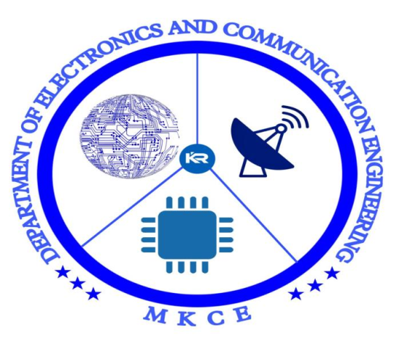

BLUETOOTH BASED NOTICEBOARD

Slide 2
TEAM MEMBERS
Aishwarya R (927621BEC008)
Arshidha U (927621BEC013)
Haasnie S (927621BEC057)
Harsela S (927621BEC063)
GUIDED BY
Dr.S. Subaselvi

Slide 3
INTRODUCTION
The main objective of the project is to develop a wireless notice board that displays notices. Voice is converted to data from the users android application devices. Remote operation is achieved by any smart phones with android OS, graphical user interface based touch screen operation.

Slide 4
OBJECTIVE
Notice board is the primary thing in any institution or organization like school ,colleges or public utility places like railway station vice versa. But sticking various notices day to day is a difficult process.

Slide 5
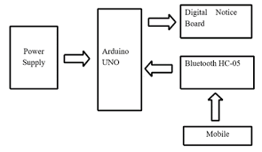
BLOCK DIAGRAM

Slide 6
WORKING
The bluetooth based noticeboard interfaces microcontroller with mobilephone bluetooth application to decode the received message and do the required action. The microcontroller pulls the message received by the phone, decodes it and displays the notice on the LCD.

Slide 7
COMPONENTS REQUIRED
Arduino UNO
HC-05 Bluetooth module
LCD Display
9v battery

Slide 8
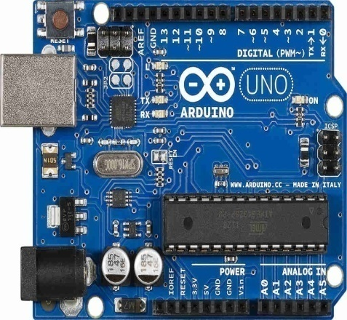
ARDUINO UNO
Arduino is an open-source electronics platform based on easy-to-use hardware and software. It can able to read inputs-lights on sensor and turn it into an output-activating a motor, turning on LED, Publishing something online. It can able to set an instructions to the microcontroller on the board. We use the Arduino programming language , and the Arduino Software , based on Processing.

Slide 9
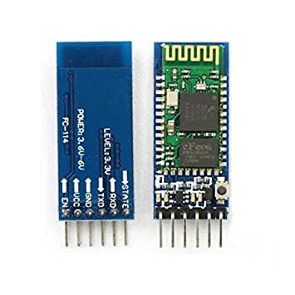
HC-05 BLUETOOTH MODULE
HC-05 Bluetooth Module is an easy to use Bluetooth SPP (Serial Port Protocol) module, designed for transparent wireless serial connection setup. Its communication is via serial communication which makes an easy way to interface with controller. HC-05 Bluetooth module provides switching mode between master and slave mode which means it able to use neither receiving nor transmitting data

Slide 10
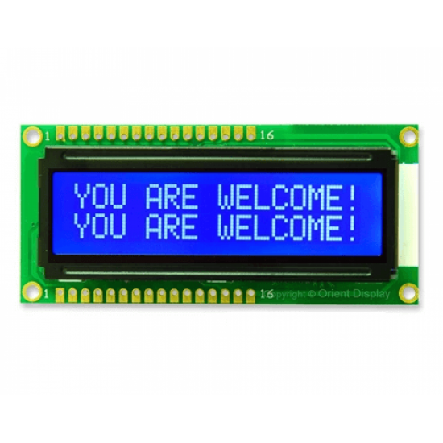
LCD DISPLAY
An LCD (Liquid Crystal Display) screen is an electronic display module and has a wide range of applications. A 16x2 LCD display is very basic module and is very commonly used in various devices and circuits. A 16x2 LCD means it can display 16 characters per line and there are 2 such lines. The 16 x 2intelligent alphanumeric dot matrix display is capable of displaying 224 different character and symbols. This LCD has two registers, namely, Command and Data

Slide 11
ADVANTAGES
The electronic notice board is wireless and no need of wires for displaying information on the LCD display.
It is very easy to operate and consumes less power.
The circuit of the wireless notice board is portable

Slide 12
FUTURE SCOPES
The applications of wireless notice board mainly include public places like bus stands, railway stations, airports, shopping malls, and parks to display the information wirelessly. This project is also used in organizations, schools, and colleges.

Slide 13
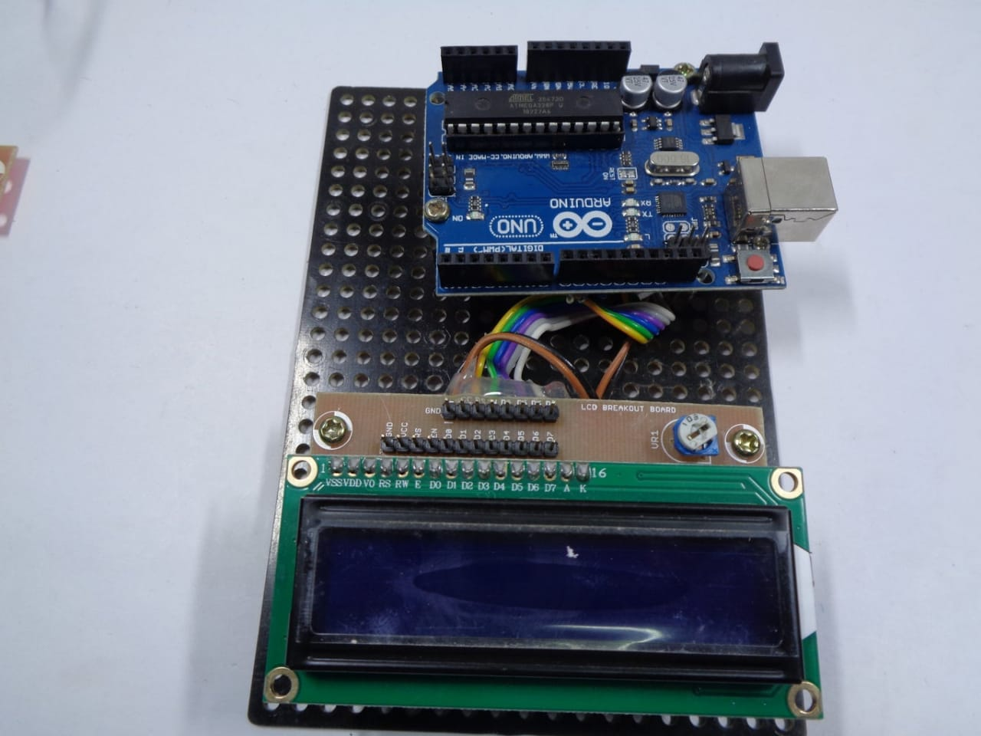
RESULT

Slide 14
CONCLUSION
The concept of wireless technology is introduced in the field of the communication we can make our communication more efficient and faster, with the greater efficiency. We have developed a voice control bluetooth wireless android application for a notice board displays the error free images and with good maintanance

Slide 15
